Slide 1
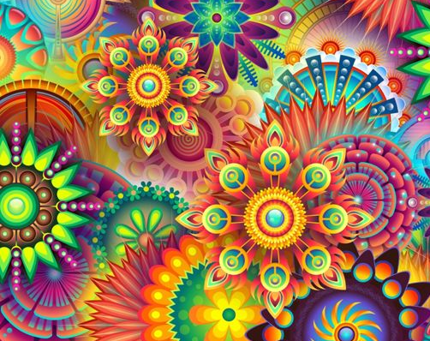
Good Drugs
(Psychopharmacology)

Slide 2
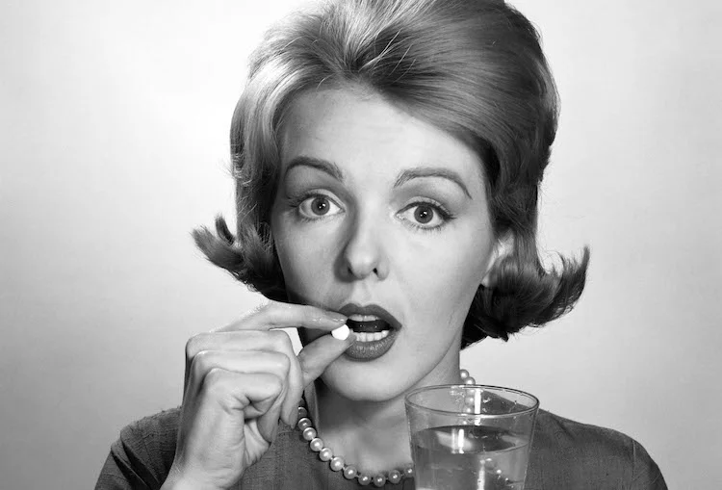
Psychiatric Medications
Psychoactive substances used to improve symptoms of mental health conditions

Slide 3
Psychiatric Medications
Psychoactive substances used to improve symptoms of mental health conditions
Examples
  Lithium
  Antipsychotics
  Amphetamines
  Benzodiazepines
  Antidepressants (SSRIs/SNRIs/MAOIs)

Slide 4
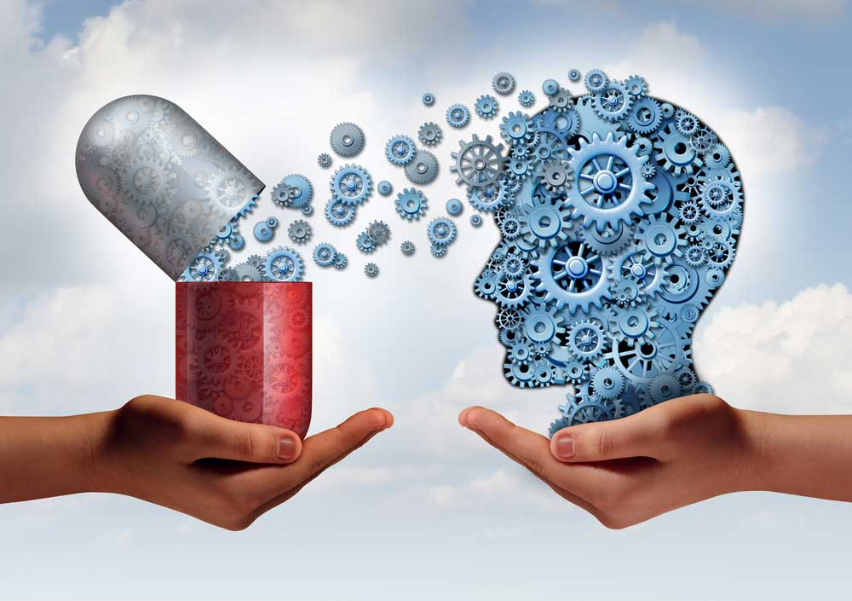
Mechanism of Action (MOA)
How a psychoactive substance acts on the brain
Effects on mental health symptoms can be
  Direct
  Indirect

Slide 5

How do we identify effective treatments?
The Ideal:
  “The brains of people with Mental Condition X have less of Neurotransmitter Y.”
  Design a drug that acts like Neurotransmitter Y.

Slide 6

How do we identify effective treatments?
The Reality:
  Mostly dumb luck

Slide 7
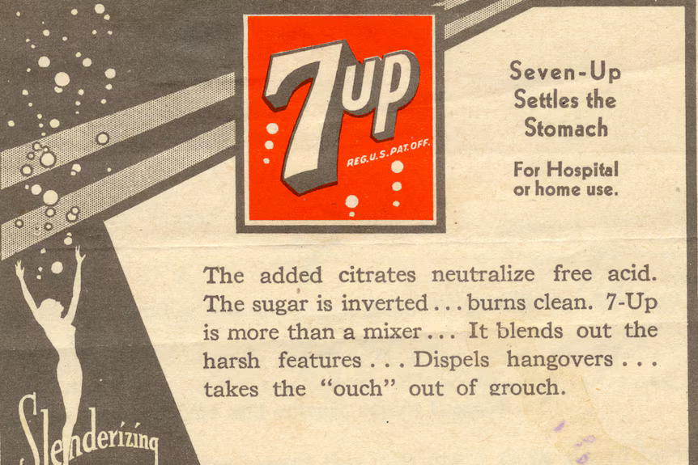
Lithium
Mood stabiliser prescribed for bipolar disorder
Lightest metal on periodic table
Found in rocks, soil, and still bodies of water
Ancient references to curative “mineral waters” may have been related to lithium levels

Slide 8
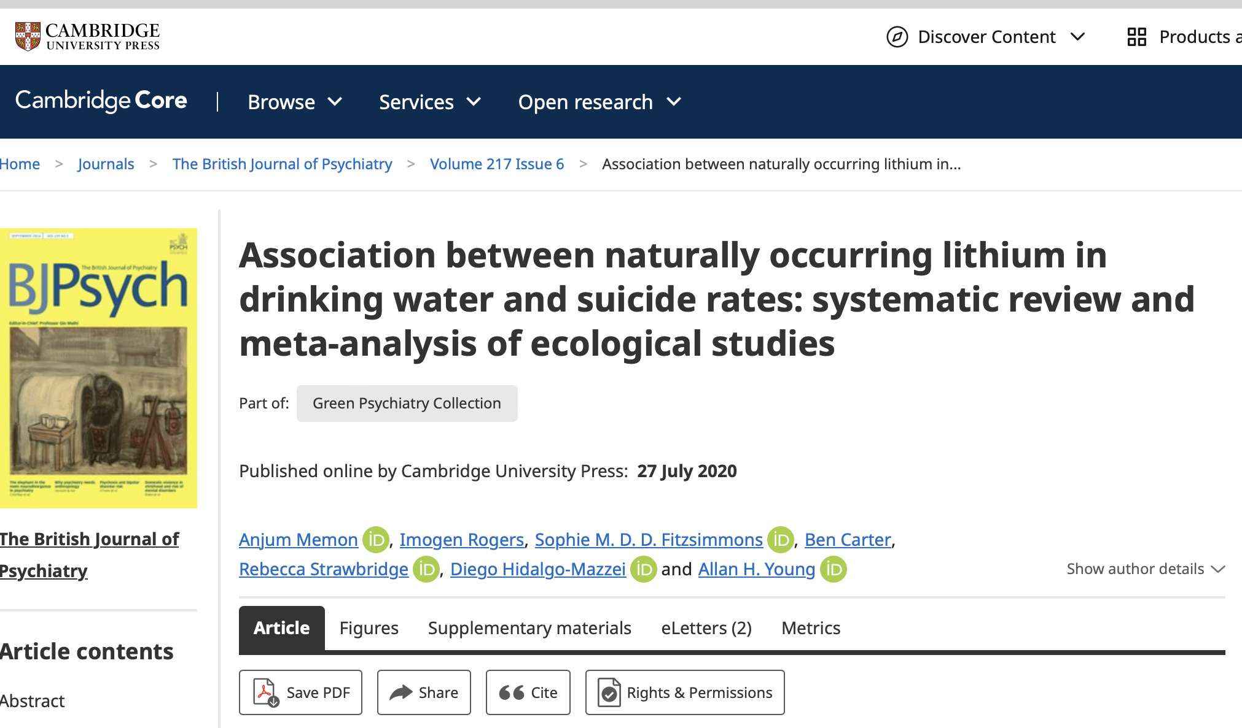
Lithium
Lithium is present in varying amounts in drinking water around the world
High levels of lithium in the drinking water have been associated with lower rates of suicide
Australian psychiatrist John Cade “rediscovered” lithium in 1949, leading to its use as a mood stabiliser

Slide 9
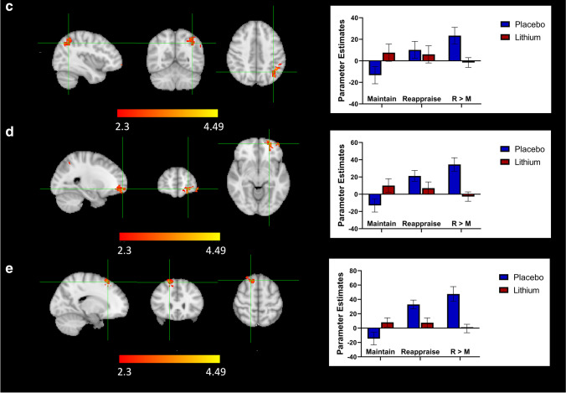
Lithium: MOA for Bipolar Disorder
Unknown!
Messy drug, impacts a lot of neurotransmitters and intracellular processes
Hortelano et al., 2023

Slide 10
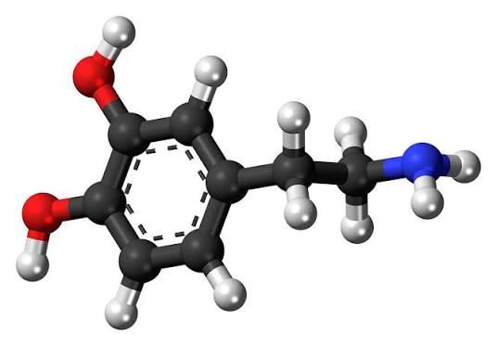
The Dopamine Drugs
Antipsychotics for Schizophrenia and Bipolar Disorder
  Dopamine antagonists
Amphetamines for ADHD
  Dopamine agonists

Slide 11
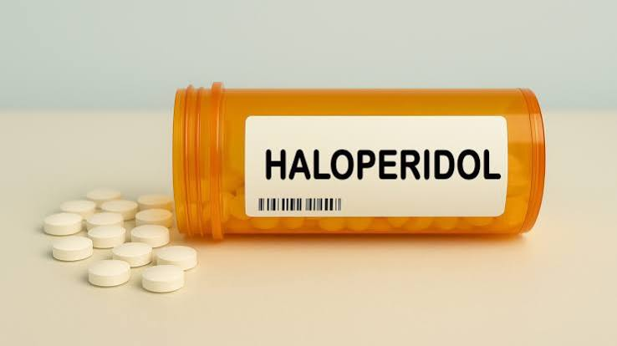
Antipsychotics
Chlorpromazine
  Synthesized in 1950 by a surgeon seeking improved options for surgical anaesthetics
  Calming effects made it a strong candidate for psychiatric disorders
Used for the first time in a “manic” patient in 1952

Slide 12
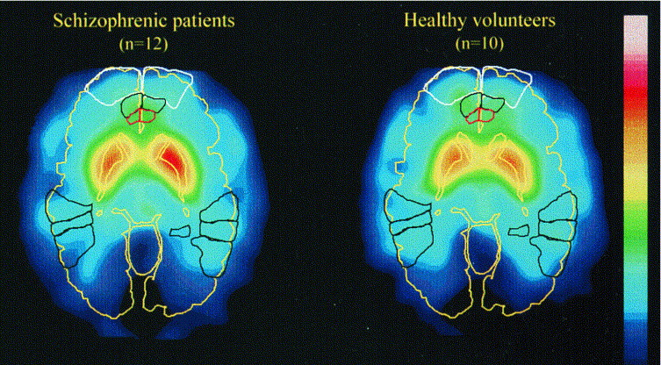
Antipsychotics: MOA for Schizophrenia
Excess dopamine activity in certain brain regions has been observed in schizophrenic patients
This “hyperdopaminergic” activity contributes to hallucinations and delusions
Blocking dopamine activity with antipsychotics “normalises” dopamine activity in these brain regions
But blocking dopamine activity in other brain regions can lead to unpleasant side effects
Lindstrom et al., 1999

Slide 13
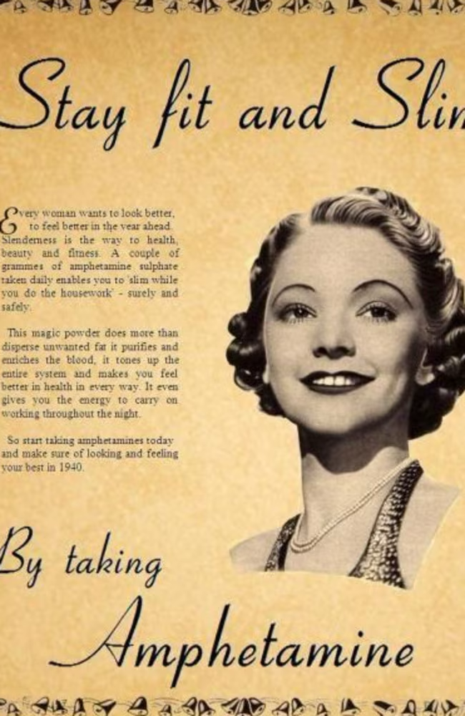
Amphetamines
Synthesised in 1887
Used in the 1920s/30s as an OTC medication for asthma, congestion, etc
Given to soldiers in WWII to enhance performance
Used as weight-loss drugs until crackdown in 1960s/1970s

Slide 14
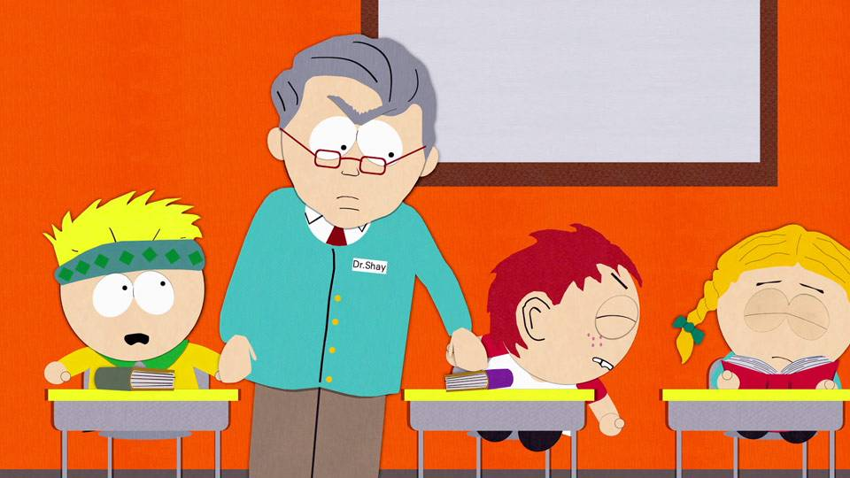
Amphetamines: Use in ADHD
First administered to children in 1937 by Charles Bradly to improve school performance in “troublesome children”
It worked…

Slide 15
Amphetamines: MOA for ADHD
Some evidence of impaired dopamine activity in ADHD
Complex condition, still under investigation

Slide 16
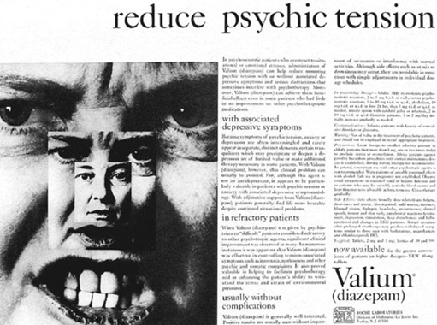
Benzodiazepines
Valium, Xanax, etc
First synthesised in 1955 as an alternative to barbiturates
Huge hit!
Most highly prescribed drugs in the world by 1977
Restricted in the 1980s due to
  Concerns about dependence
  Increasing popularity of SSRIs

Slide 17
Benzodiazepines: MOA for anxiety
GABA Agonist (increases inhibitory neurotransmission)
At low doses, selectively reduces neural activity in areas like the prefrontal cortex and amygdala
At higher doses, causes sedation
Highly effective
Potentially addictive
  Intended for short-term use only!

Slide 18

Antidepressants and the “Monoamine Hypothesis”
Earliest antidepressants (1950s):
  Monoamine oxidase inhibitors (MAOIs)
    Discovered while searching for antitubercular medications
  Tricyclic Antidepressants
    Discovered while searching for effective antipsychotics
First “intentionally designed” psychotropic medication:
  Selective Serotonin Reuptake Inhibitors (SSRIs)
  Developed in 1970s, rolled out in 1980s
  Most widely prescribed psychiatric medications in the world

Slide 19
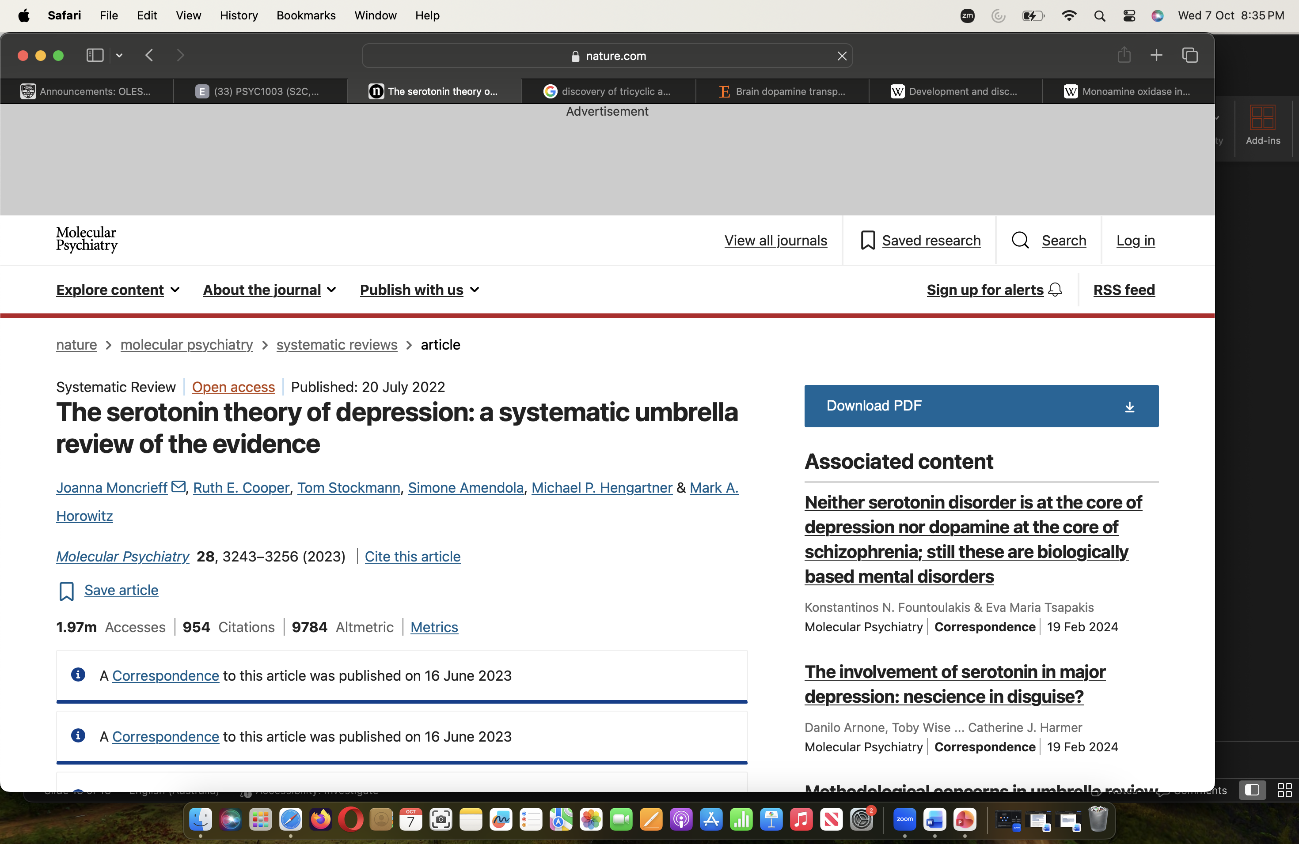
The Monoamine Hypothesis of Depression
Antidepressants work by increasing monoamines (serotonin, norepinephrine, dopamine), ergo depression is caused by not having enough monoamines (particularly serotonin)
FALSE

Slide 20
The Monoamine Hypothesis of Depression
Antidepressants work by increasing monoamines (serotonin, norepinephrine, dopamine), ergo depression is caused by not having enough monoamines (particularly serotonin)
FALSE
BUT! Just because they don’t work like we thought they did, doesn’t mean they don’t work.

Slide 21
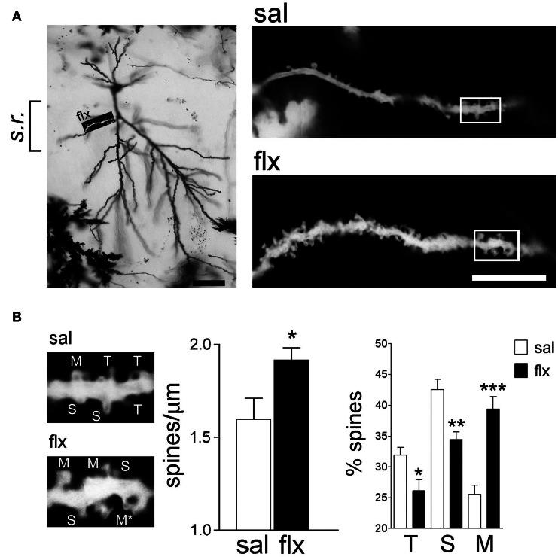
Chronic SSRIs promote dendritic spine growth in the hippocampus
Long-term (chronic) use of antidepressants increases plasticity in the hippocampus
Rubio et al., 2013

Slide 22
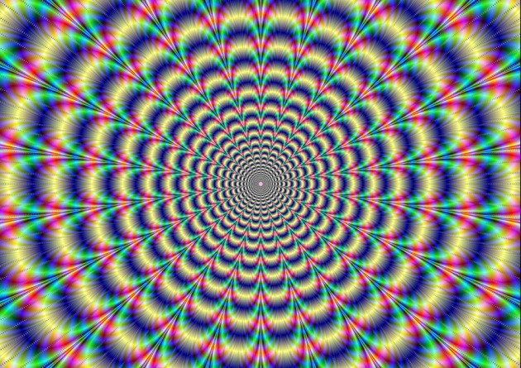
Novel Pharmacotherapies
Period of stagnation in the development of new psychiatric med occurred between 1987 (official roll-out of Prozac) and 2019…

Slide 23
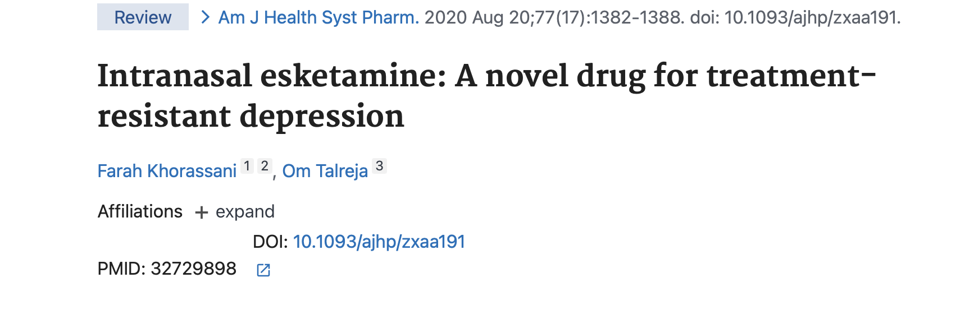
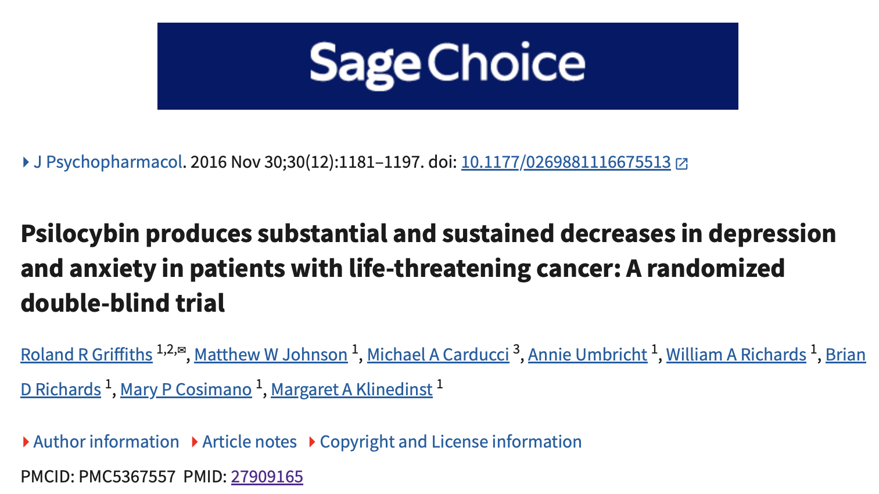
The promise of plasticity-promoting drugs in treating depression
Treatment-Resistant Depression
Ketamine (FDA approval 2019, TGA approval 2021)
Psilocybin/Psilocybin-assisted psychotherapy (TGA approval 2023)

Slide 24
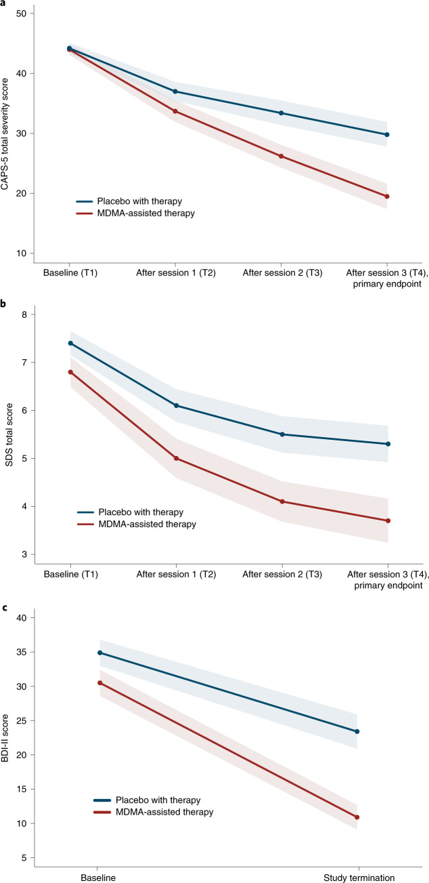
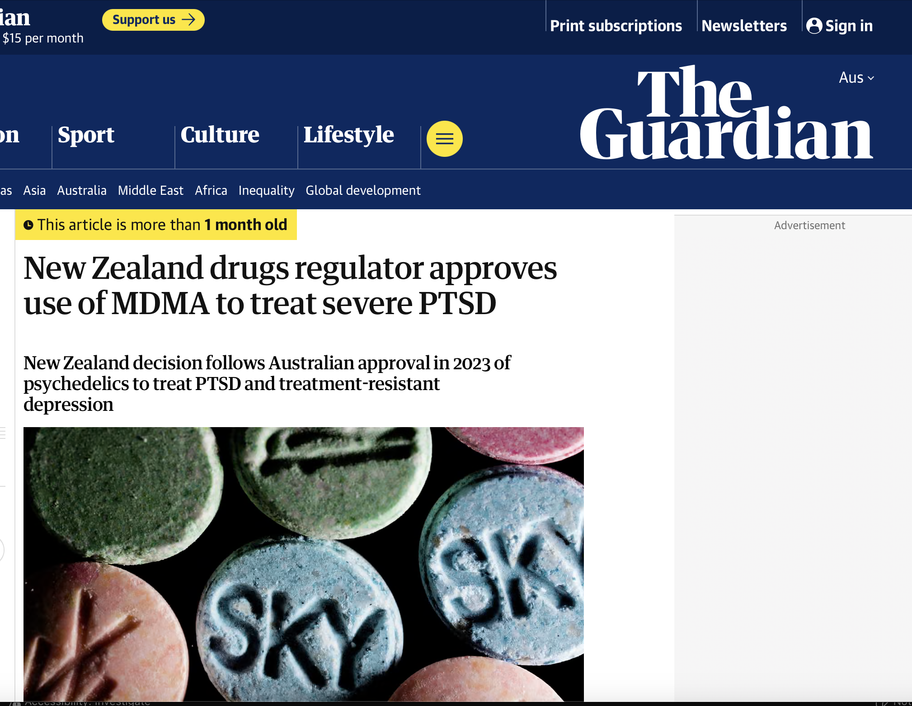
MDMA-assisted psychotherapy for PTSD
Mitchell et al., 2021

Slide 25
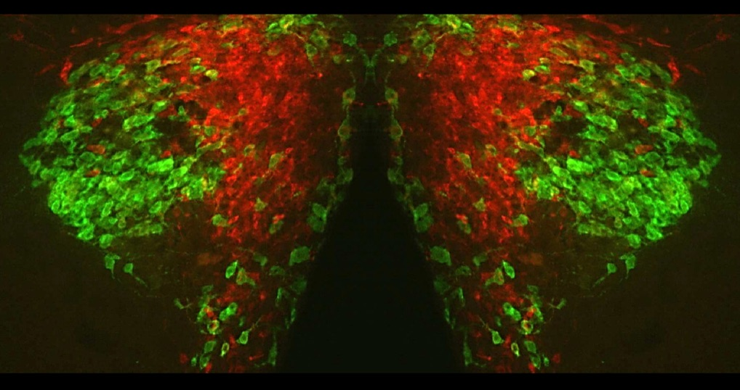
MDMA-assisted psychotherapy for PTSD
MOA
Increases monoamines, neuroplasticity, and oxytocin
Decreases stress response, promotes social bonding
Inhibits fear

Slide 26
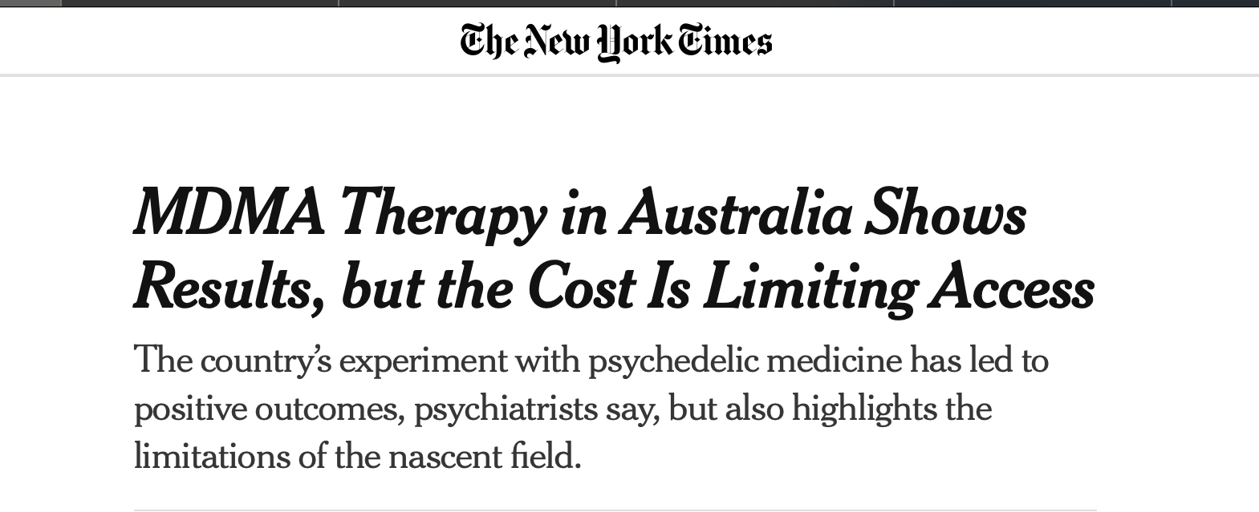
Ketamine, Psilocybin, MDMA
Advantages:
Rapidly-acting
Effects can be strong and sustained
Doesn’t require daily pills
Disadvantages:
Expensive to access
Usually requires monitoring/treatment by psychiatrist and psychologist
Optimal treatment protocols still being developed
Risks still being assessed

Slide 27
Summary Timeline
1920s/30s
  Amphetamines
1950s
  First “boom” in psychiatric medications
  Lithium, antipsychotics, benzodiazepines, first-gen antidepressants (TCAs and MAOIs)
1960s
  First psychedelic boom in research, ruined for decades by overly “enthusiastic” researchers
1970s
  MDMA began to be used for trauma therapy before it became a popular club drug and was quickly restricted
1980s
  SSRIs
2000s
  Antidepressant effects of low-dose ketamine discovered
  Rediscovery of therapeutic benefits of psilocybin and MDMA

Slide 28
Summary: How do psychiatric medications improve symptoms?
Correcting an abnormality in neural function
  Antipsychotics
Reducing or increasing general activity
  Anxiolytics (benzodiazepines)
  Stimulants (amphetamines)
Increasing neuroplasticity
  Antidepressants
Increasing effects of cognitive behavioural therapy (“pharmacological adjuncts” to therapy)
  MDMA
  Psilocybin
  “Cognitive enhancers”

Slide 29
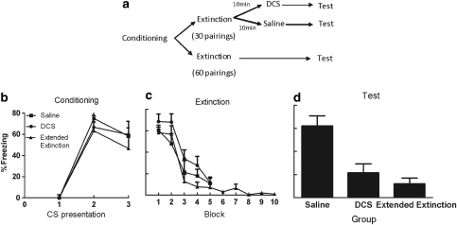
Cognitive enhancers and animal research
Fear extinction is used as a model of exposure therapy
Can “cognitive enhancers” improve the effects of extinction?
An example: DCS
McCallum et al., 2010

